Slide 1
BLM267
Chapter 7: Stacks

Slide 2
Applications of Stacks
Reversing a List
A list of numbers can be reversed by reading each number from an array starting from the first index and pushing it on a stack.
Once all the numbers have been read, the numbers can be popped one at a time and then stored in the array starting from the first index.

Slide 3
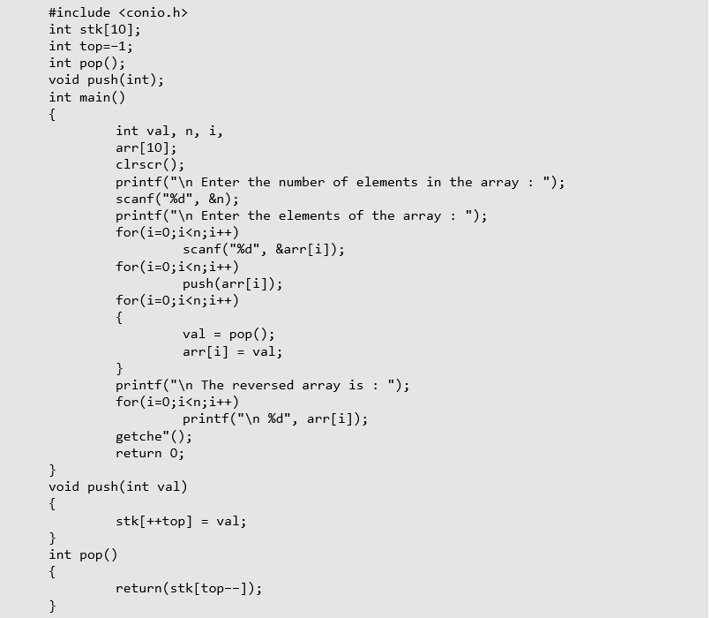
Applications of Stacks

Slide 4
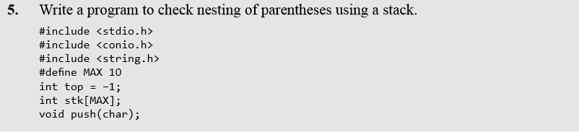
Applications of Stacks
Implementing Parentheses Checker
Stacks can be used to check the validity of parentheses in any algebraic expression.
For example, an algebraic expression is valid if for every open bracket there is a corresponding closing bracket.
For example, the expression (A+B} is invalid but an expression {A + (B – C)} is valid.
Look at the program below which traverses an algebraic expression to check for its validity.

Slide 5
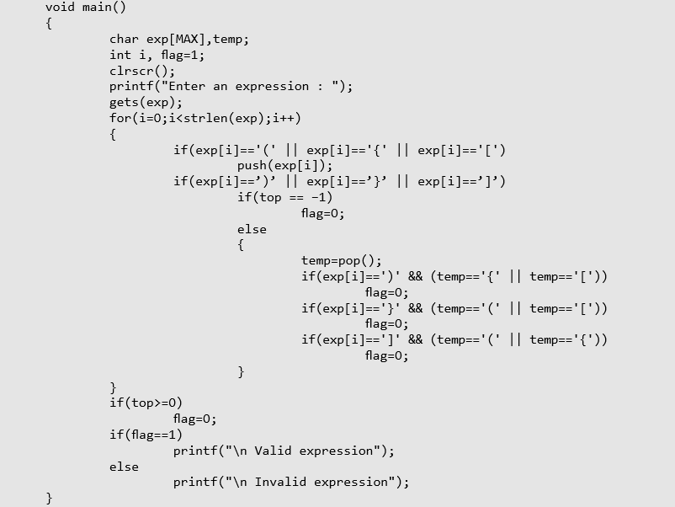
Applications of Stacks

Slide 6
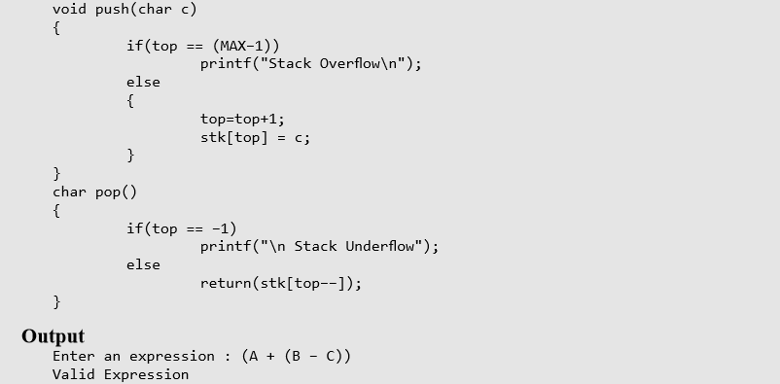
Applications of Stacks

Slide 7
Applications of Stacks
Evaluation of Arithmetic Expressions
Polish Notations
Infix, postfix, and prefix notations are three different but equivalent notations of writing algebraic expressions.
But before learning about prefix and postfix notations, let us first see what an infix notation is.
We all are familiar with the infix notation of writing algebraic expressions.
While writing an arithmetic expression using infix notation, the operator is placed in between the operands.
For example, A+B; here, plus operator is placed between the two operands A and B.
Although it is easy for us to write expressions using infix notation, computers find it difficult to parse as the computer needs a lot of information to evaluate the expression.
Information is needed about operator precedence and associativity rules, and brackets which override these rules.
So, computers work more efficiently with expressions written using prefix and postfix notations

Slide 8
Applications of Stacks
Evaluation of Arithmetic Expressions
In postfix notation, as the name suggests, the operator is placed after the operands.
For example, if an expression is written as A+B in infix notation, the same expression can be written as AB+ in postfix notation.
The order of evaluation of a postfix expression is always from left to right.
Even brackets cannot alter the order of evaluation.
The expression (A + B) * C can be written as: AB+C* in the postfix notation.

Slide 9
Applications of Stacks
Evaluation of Arithmetic Expressions
Although a prefix notation is also evaluated from left to right, the only difference between a postfix notation and a prefix notation is that in a prefix notation, the operator is placed before the operands.
For example, if A+B is an expression in infix notation, then the corresponding expression in prefix notation is given by +AB.
While evaluating a prefix expression, the operators are applied to the operands that are present immediately on the right of the operator.
Like postfix, prefix expressions also do not follow the rules of operator precedence and associativity, and even brackets cannot alter the order of evaluation.

Slide 10
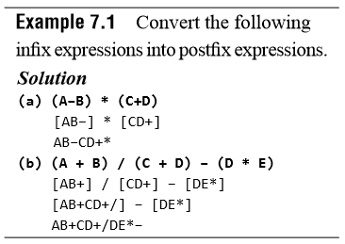
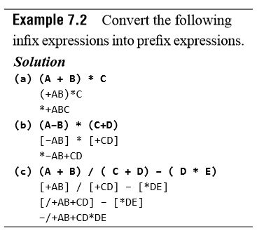
Applications of Stacks

Slide 11
Applications of Stacks
Conversion of an Infix Expression into a Postfix Expression
The algorithm given below transforms an infix expression into postfix expression, as shown in Fig. 7.22.
The algorithm accepts an infix expression that may contain operators, operands, and parentheses.
For simplicity, we assume that the infix operation contains only modulus (%), multiplication (*), division (/), addition (+), and subtraction (―) operators and that operators with same precedence are performed from left-to-right.
The algorithm uses a stack to temporarily hold operators.
The postfix expression is obtained from left-to-right using the operands from the infix expression and the operators which are removed from the stack.
The first step in this algorithm is to push a left parenthesis on the stack and to add a corresponding right parenthesis at the end of the infix expression.
The algorithm is repeated until the stack is empty.

Slide 12
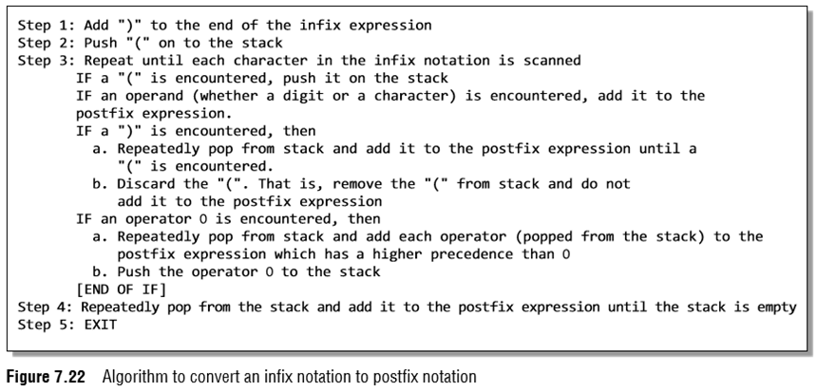
Applications of Stacks
Conversion of an Infix Expression into a Postfix Expression

Slide 13
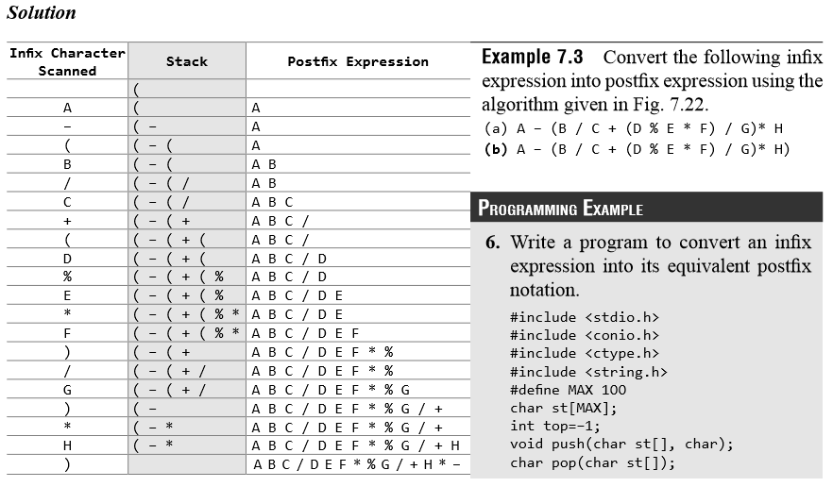
Applications of Stacks
Conversion of an Infix Expression into a Postfix Expression

Slide 14
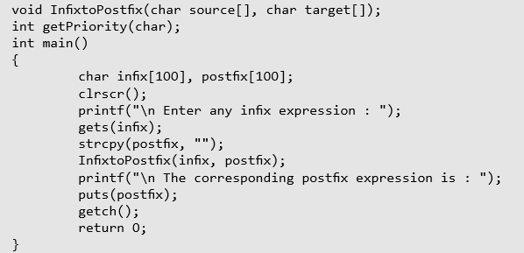
Applications of Stacks

Slide 15
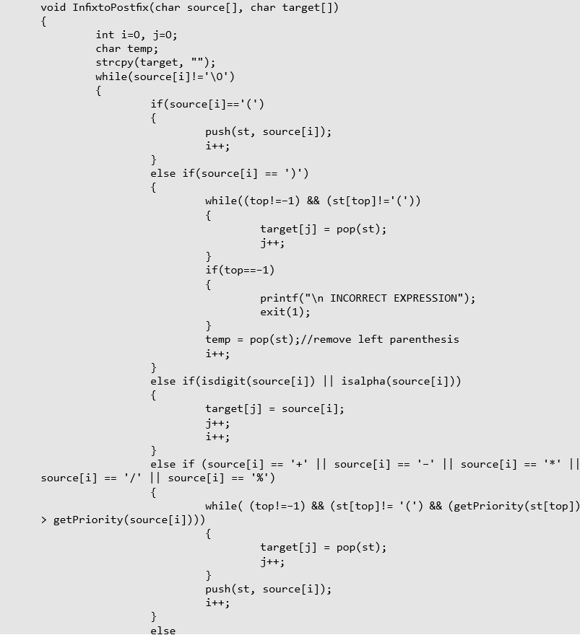
Applications of Stacks

Slide 16
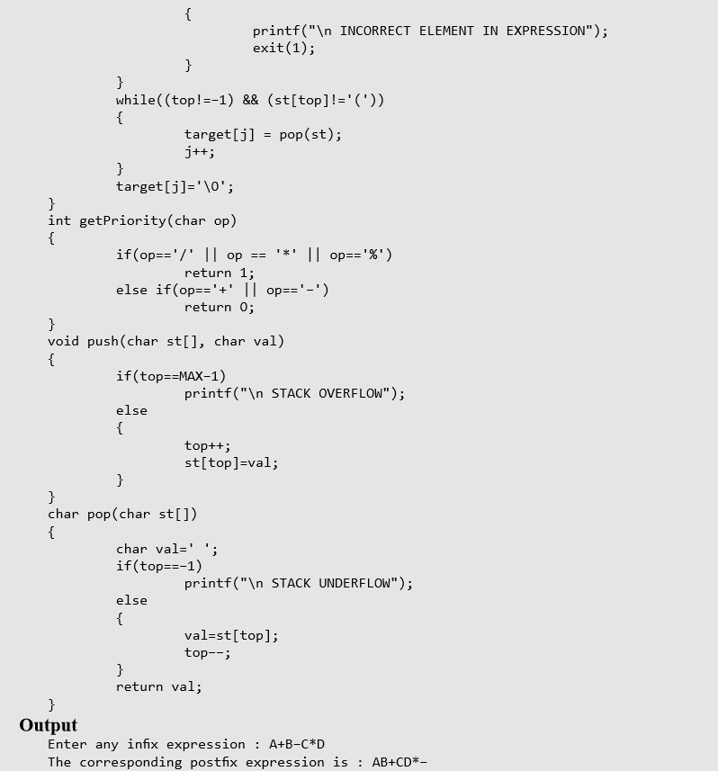
Applications of Stacks

Slide 17
Applications of Stacks
Evaluation of a Postfix Expression
The ease of evaluation acts as the driving force for computers to translate an infix notation into a postfix notation.
That is, given an algebraic expression written in infix notation, the computer first converts the expression into the equivalent postfix notation and then evaluates the postfix expression.
Both these tasks—converting the infix notation into postfix notation and evaluating the postfix expression—make extensive use of stacks as the primary tool.

Slide 18
Applications of Stacks
Evaluation of a Postfix Expression
Using stacks, any postfix expression can be evaluated very easily.
Every character of the postfix expression is scanned from left to right.
If the character encountered is an operand, it is pushed on to the stack.
However, if an operator is encountered, then the top two values are popped from the stack and the operator is applied on these values.
The result is then pushed on to the stack. Let us look at Fig. 7.23 which shows the algorithm to evaluate a postfix expression.

Slide 19
Applications of Stacks
Evaluation of a Postfix Expression
Let us now take an example that makes use of this algorithm.
Consider the infix expression given as 9 – ((3 * 4) + 8) / 4. Evaluate the expression.
The infix expression 9 – ((3 * 4) + 8) / 4 can be written as 9 3 4 * 8 + 4 / – using postfix notation.

Slide 20
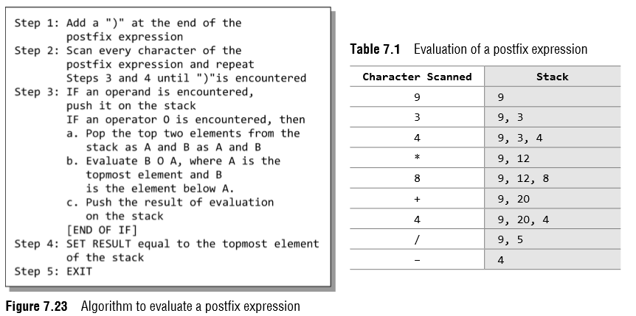
Applications of Stacks
Evaluation of a Postfix Expression
9 3 4 * 8 + 4 / –
9 3 4 * 8 + 4 / – )

Slide 21
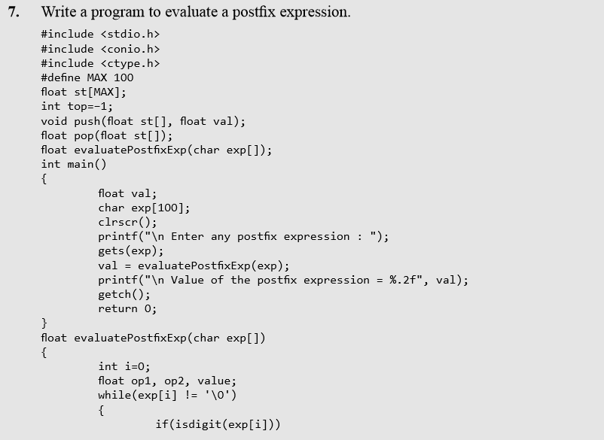
Applications of Stacks

Slide 22
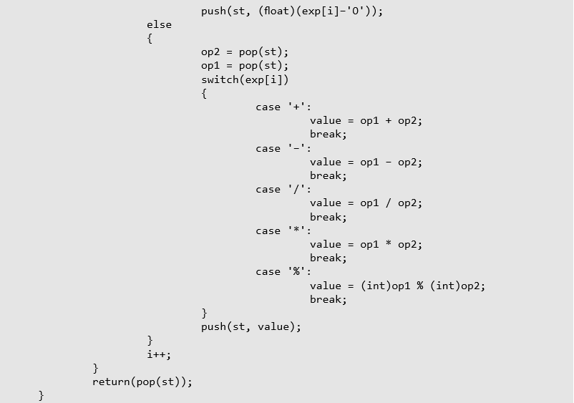
Applications of Stacks

Slide 23
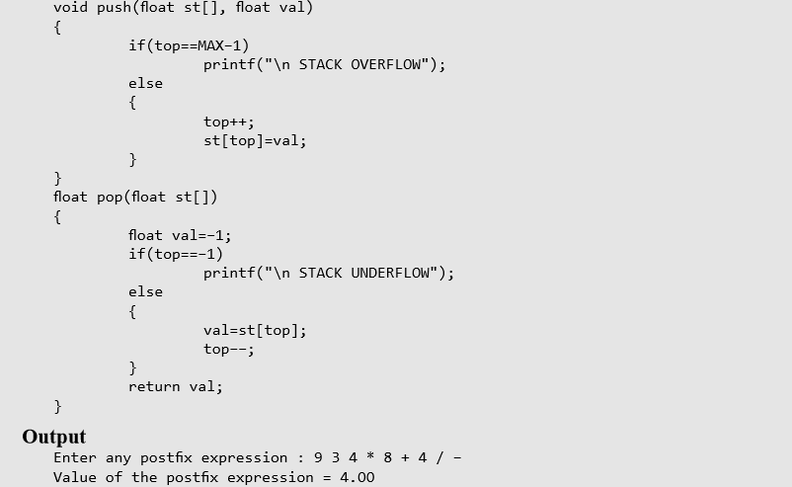
Applications of Stacks

Slide 24
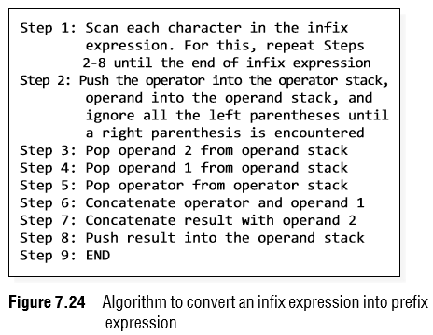
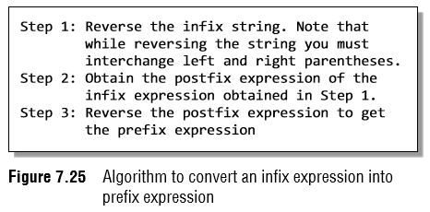
Applications of Stacks
Conversion of an Infix Expression into a Prefix Expression
There are two algorithms to convert an infix expression into its equivalent prefix expression.
The first algorithm is given in Fig. 7.24, while the second algorithm is shown in Fig. 7.25.

Slide 25
Applications of Stacks
Conversion of an Infix Expression into a Prefix Expression
Given an infix expression (A – B / C) * (A / K – L)
Step 1:Reverse the infix string. Note that while reversing the string you must interchange left and right parentheses.
(L – K / A) * (C / B – A)
Step 2:Obtain the corresponding postfix expression of the infix expression obtained as a result of Step 1.
The expression is: (L – K / A) * (C / B – A)
[L – (K A /)] * [(C B /) – A]
= [LKA/–] * [CB/A–]
= L K A / – C B/A – *
Step 3:Reverse the postfix expression to get the prefix expression
* – A / B C – /A K L

Slide 26
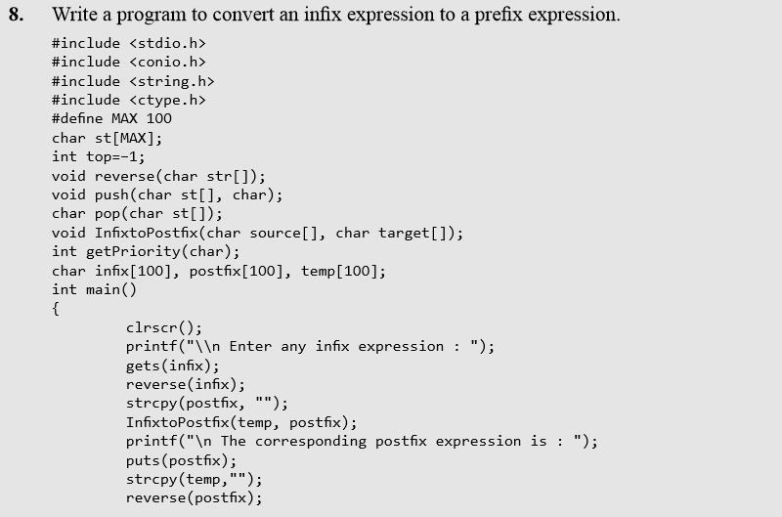
Applications of Stacks

Slide 27
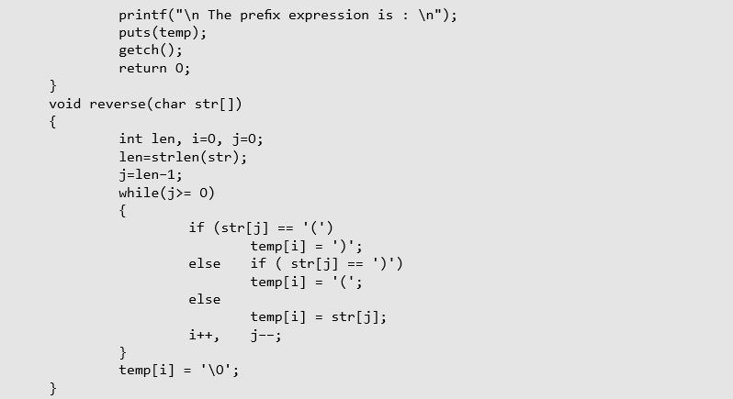
Applications of Stacks

Slide 28
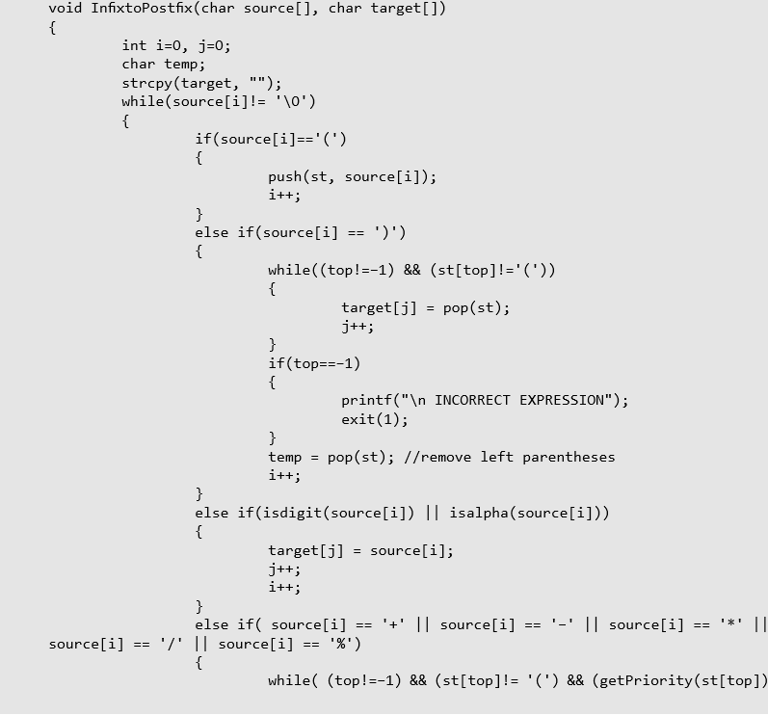
Applications of Stacks

Slide 29
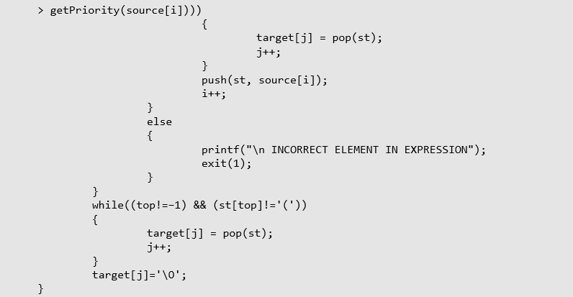
Applications of Stacks

Slide 30
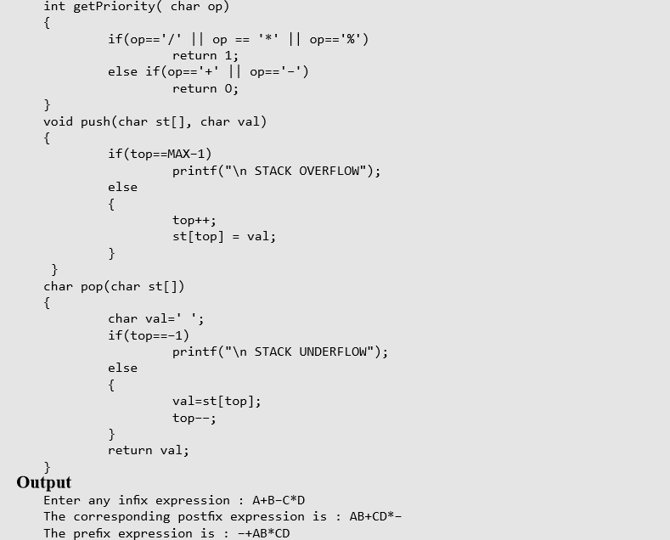
Applications of Stacks

Slide 31
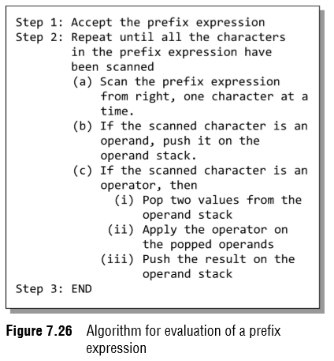
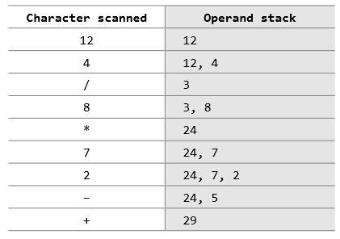
Applications of Stacks
Evaluation of a Prefix Expression
The way of evaluation of a prefix expression is given in Fig. 7.26.
For example, consider the prefix expression + – 2 7 * 8 / 4 12.
Let us now apply the algorithm to evaluate this expression.

Slide 32
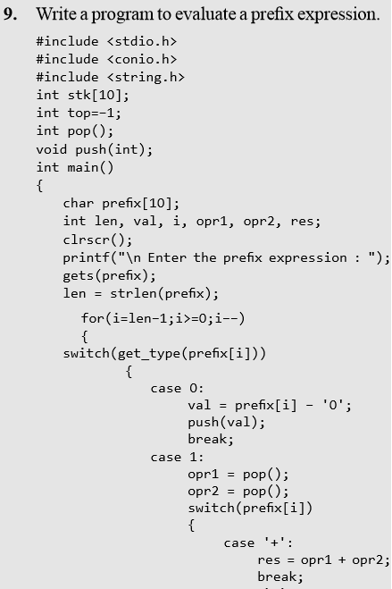
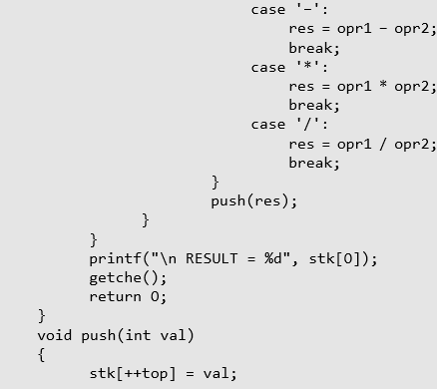
Applications of Stacks

Slide 33
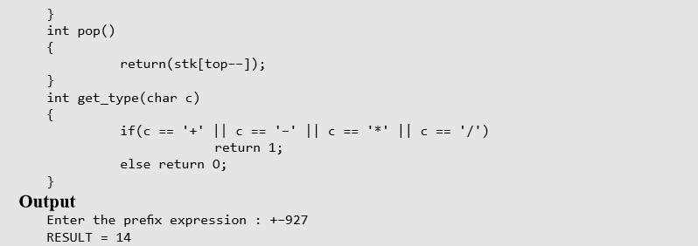
Applications of Stacks

